Slide 1

AUGMENTING DATA CATALOGS BY INCORPORATING DATA FITNESS DISTRIBUTIONS
Team Fitness Fusion
Sprint 4

Slide 2





Team Members
Name – Sohan Bommidi Scrum Master
Name – Yumna Zaidi Product Owner
Name – Neehar Bujimalla Developer
Name – Saikiran Reddy Komatireddy Developer
Name – Venkata Karanveer Bejjam Developer

Slide 3

PARTNER SLIDE
TOPIC :
AUGMENTING DATA CATALOGS BY INCORPORATING DATA FITNESS
DOMAIN :
DATA MANAGEMENT
PARTNERS :
DR. CHARLES HOWARD
PROF SAM ANSARI

Slide 4
AGENDA
Problem Space
Algorithms and Modeling
Issues with current Data Catalogs
Modeling and Analyzing data to generate fitness features
1
2
3
4
Exploring and Transforming Data and Catalog
Results and Visualization
Presenting fitness scores and summary features in a UI
Transforming Data and Metadata to generate features

Slide 5

Introduction to Data Cataloging

Slide 6
Catalog Dilemmas
Awareness
Relevance
Features Understanding
Analytical Scope
Insightful

Slide 7



Problem Space and Project Scope
Problem
Domain
Solution
The problem is to enhance an existing data catalog system by incorporating data fitness attributes.
Data fitness includes factors such as data accuracy, completeness, timeliness, and relevance
The problem falls within the domain of Data Management.
It combines aspects of data science, metadata management, user interface design, and potentially machine learning.
This solution enhances data catalog accessibility, filtering efficiency, and dataset identification, incorporating factors like relevance, significance, and key descriptors within the data catalog.

Slide 8



Catalog Features Incorporated
General Data Fitness
Domain Specific Fitness
Thumbnail Features
Analyzing data to generate general data fitness scores
Analyzing Data to generate domain specific fitness scores
Processing metadata and data to generate thumbnail text and features

Slide 9

Datasets

Slide 10



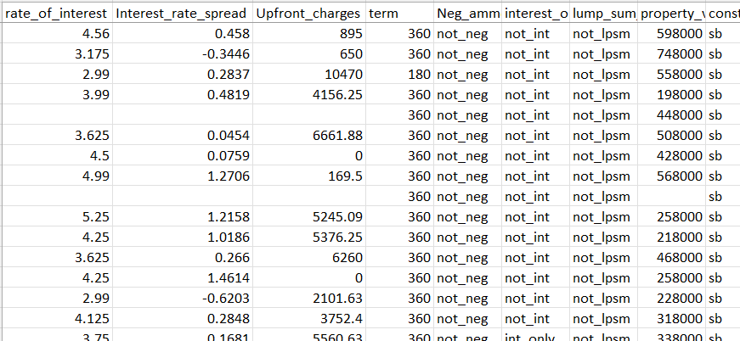
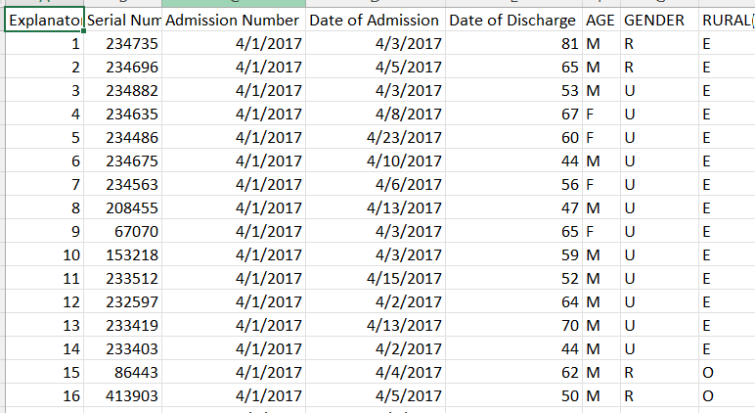


Datasets Details
Loan Default Dataset
Credit Card Dataset
It consists of multiple deterministic factors like borrower's income, gender, loan purpose etc.
It consists of 10,000 customers mentioning their age, salary, marital status, credit card limit, credit card category, etc.
Hospital Admission Dataset
Hospital Mortality Dataset
Contains patient-related information, encompassing admission and discharge dates, patient demographics, and medical history
Contains demographic characteristics, vital signs within the first 24 hours of admission, comorbidities identified by ICD-9 codes, and laboratory variables.
Raw Data

Slide 11

Extracted Features – Output Catalog Features
Fitness Score | Key Descriptors | Key Topics | Dataset Summary
7.8 | PLATELETS, GLUCOSE, B-TYPE NATRIURETIC PEPTIDE ……. | Cardiology, Heart …….... | Understanding the prevalence and risk factors associated with chronic conditions….
It is the aggregated score calculated after combining domain specific and general fitness scores | These are the variables from the dataset which contains most information | Key Topics extracted from the columns of the Dataset | Summary of the Dataset description.
x

Slide 12

Project Schematic

Slide 13
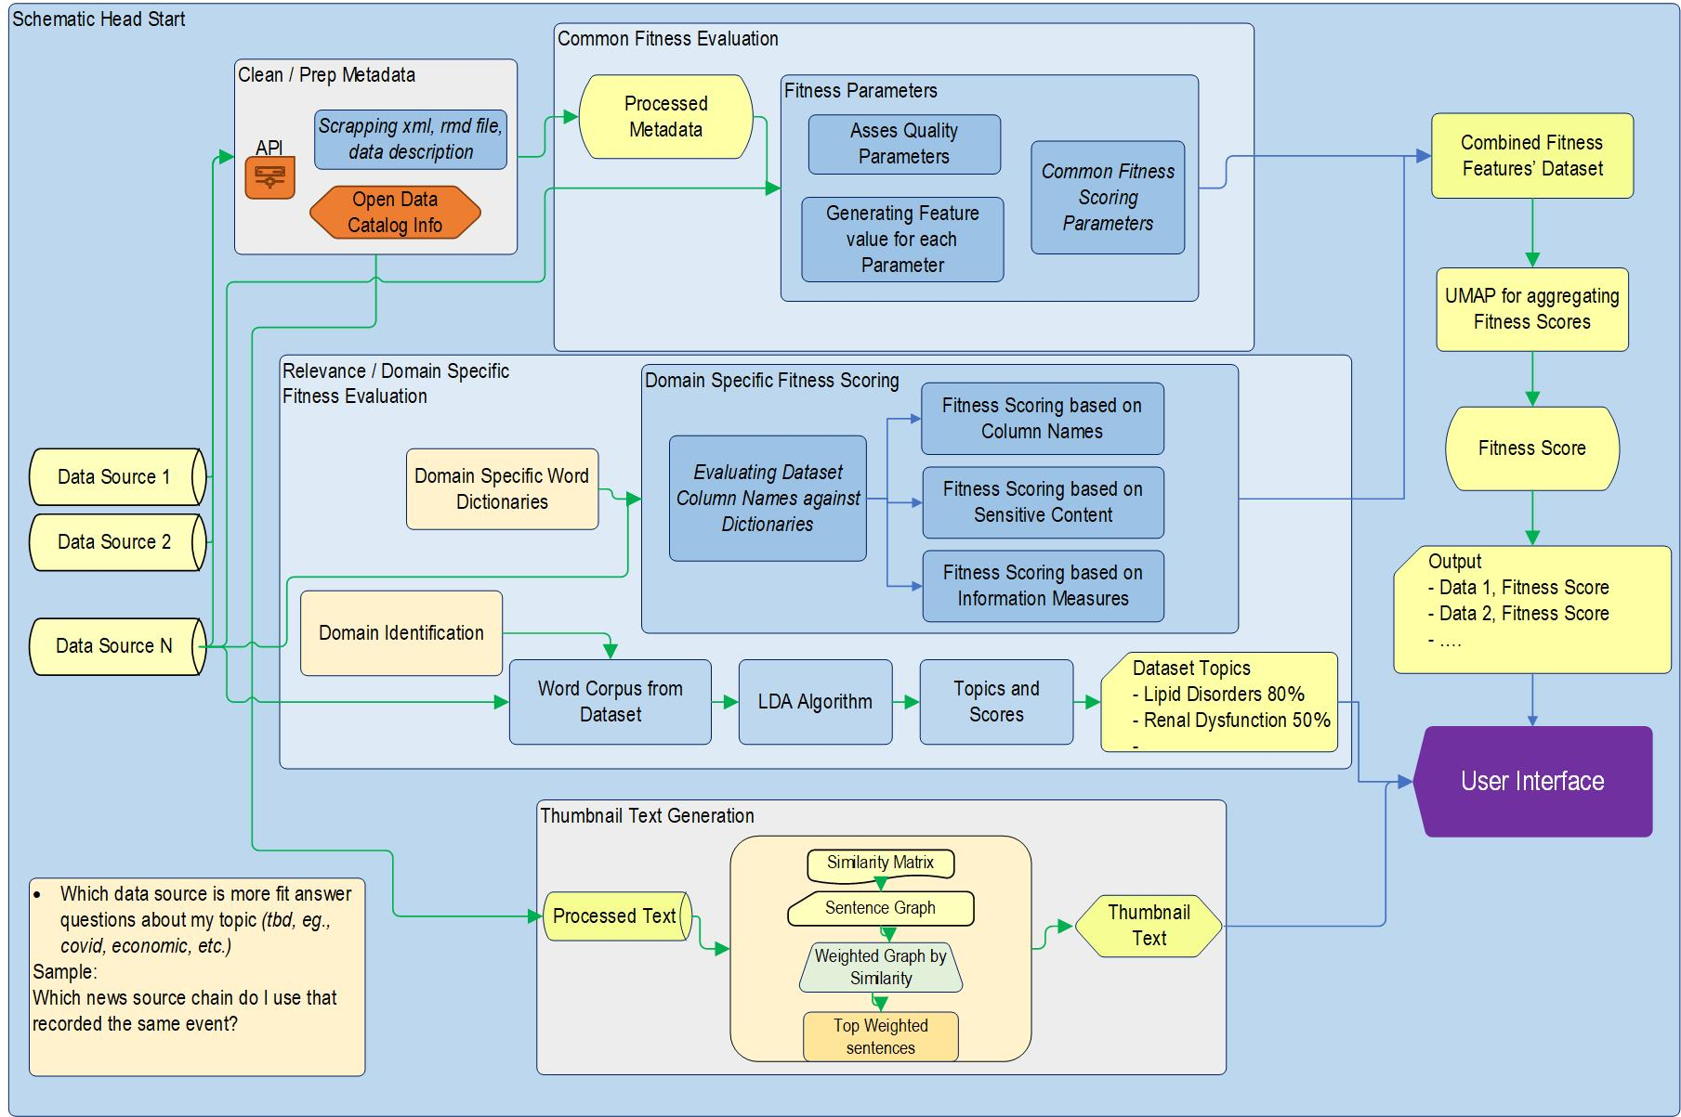
SCHEMATIC FLOW

Slide 14

General Data Fitness

Slide 15
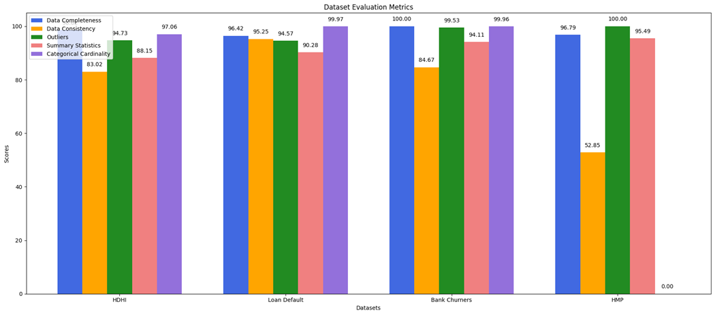
DATA QUALITY METRICS
Data Completeness - Missing Values:
= (Count Of Missing Values) x 100 / Total Length Of Dataset
= 100 − Mean of Missing Percentage
Data Consistency - Duplicate Records:
= (Count of Duplicate Records) × 100 / Total Length of Dataset
= 100 − Duplicate Percentage
Outlier Detection:
Applied Interquartile Range (IQR) to identify outliers in numeric columns.
Summary of Statistics :
Range, and Standardized quality scores, a holistic and quantifiable data quality evaluation.
Categorical Cardinality :
= Minimum Score + (Count of Unique Values) × (Maximum Score − Minimum Score)

Slide 16

Domain Specific Fitness Evaluation (Relevance)

Slide 17
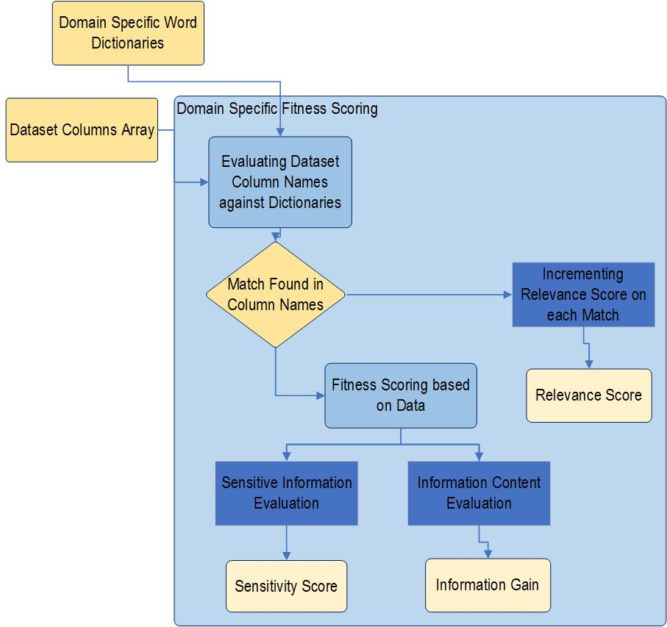
Domain Specific Features Schematic Flow
Algorithmic Flow for Domain Specific Feature Extraction

Slide 18
Domain Specific Features Extracted
Finance
Healthcare
Relationship Score
Economic Significance
Sensitivity
Granularity
Granularity
Sensitivity
Relationship Score
Epidemiological Value

Slide 19
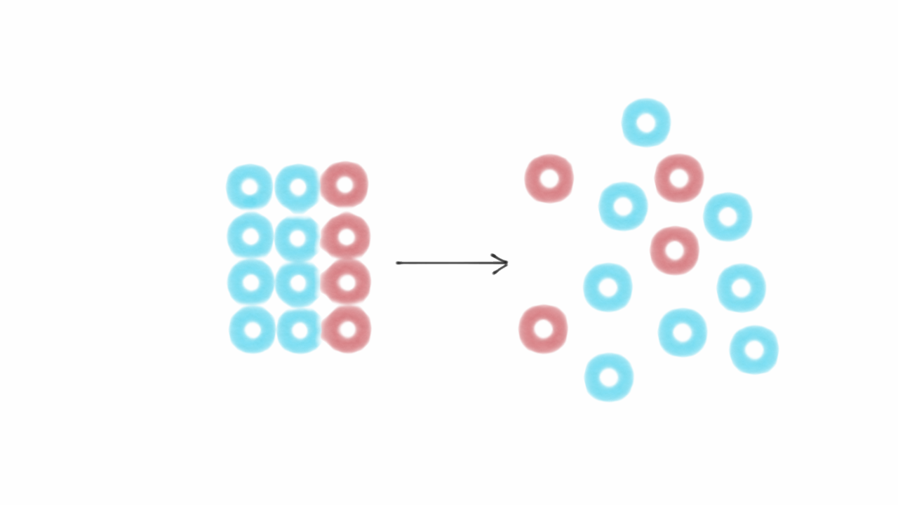
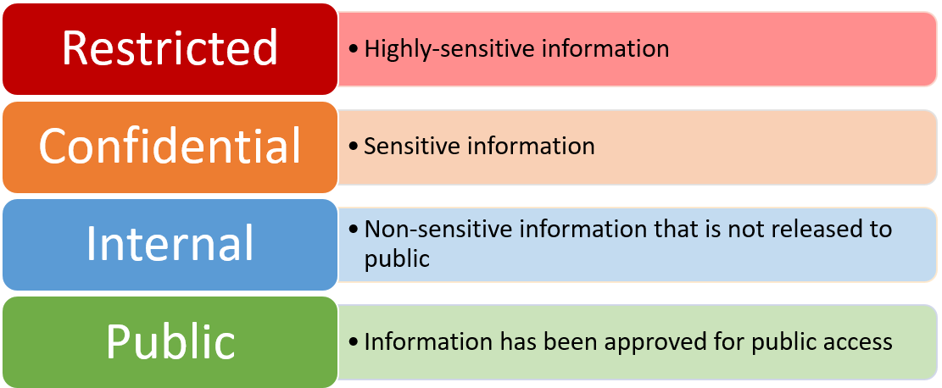
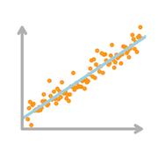

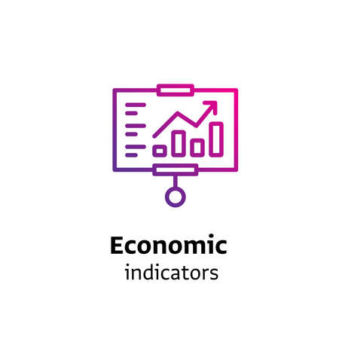
Domain Specific Features’ Evaluation
Granularity, as calculated from entropy, serves as a quantitative measure of the information content or uncertainty within a dataset.
Determining the sensitivity score involves assessing the degree of confidentiality and potential impact associated with the disclosed data.
Relationship score is determined using the correlation of columns involves assessing the statistical association between variables.
Epidemiological Score: 7
Determining an epidemiological score by matching column names from an epidemiological corpus involves aligning and comparing dataset columns with relevant epidemiological terms.
Determining the Economic significance of a dataset is gauged through metrics such as Profitability Ratio and Interest Coverage Ratio. These financial indicators provide insights into the financial health of a business, thereby offering a comprehensive perspective on the economic impact of the dataset.

Slide 20
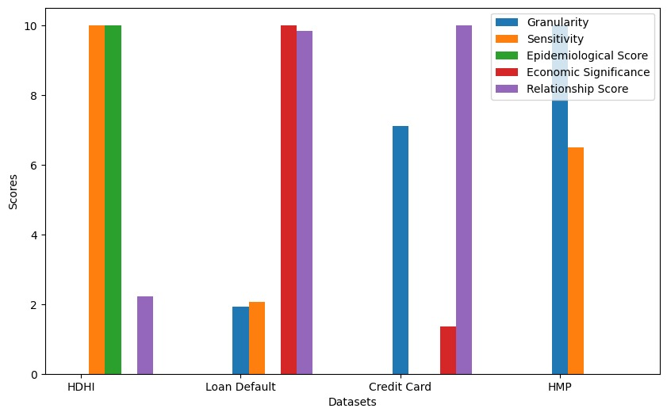
DOMAIN SPECIFIC FEATURES - RELEVANCE

Slide 21

Overall Fitness Score

Slide 22
Fitness Data frame
Quality
Relevance
DATASET NAME | Data Completeness | Data Consistency | Outliers | Summary Statistics | Categorical Cardinality | Granularity | Sensitivity | Epidemiological Score | Economic Significance | Relationship Score
HDHI | 98.62 | 83.02 | 94.73 | 88.15 | 97.06 | 2.42 | 128 | 7 | 0 | 0.037
Loan Default | 96.42 | 95.25 | 94.57 | 90.28 | 99.97 | 3.29 | 51 | 0 | 0.5 | 0.085
Credit Card | 100 | 84.67 | 99.53 | 94.11 | 99.96 | 5.63 | 31 | 0 | 0.068 | 0.086
HMP | 96.79 | 52.85 | 100 | 95.49 | 0 | 6.94 | 94 | 2 | 0 | 0.023

Slide 23
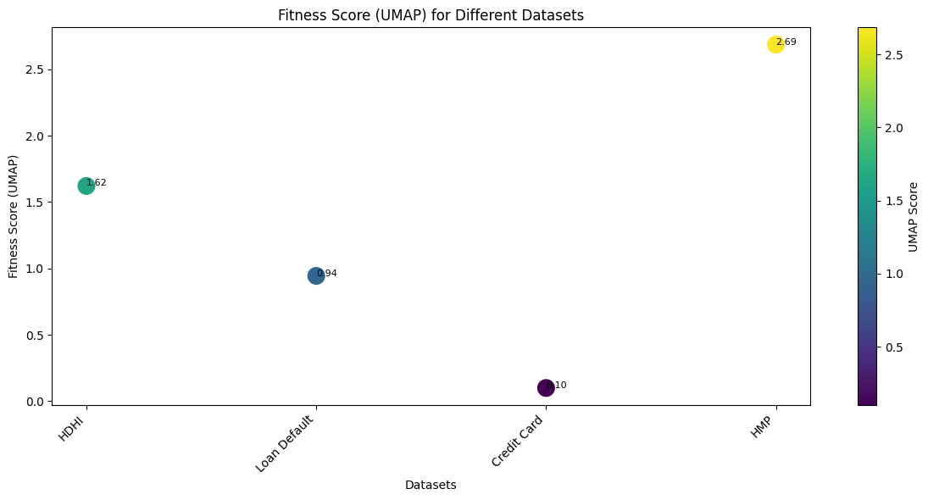
Fitness Score Aggregation using UMAP
Uniform Manifold Approximation and Projection
UMAP is a dimensionality reduction technique used for visualizing high-dimensional data in lower dimensions.
Preservation of Local Structure
Non-Linearity
Versatility
Scalability
UMAP is a powerful tool for dimensionality reduction, offering a balance between preserving local and global structures, making it a valuable asset in exploratory data analysis and visualization.

Slide 24
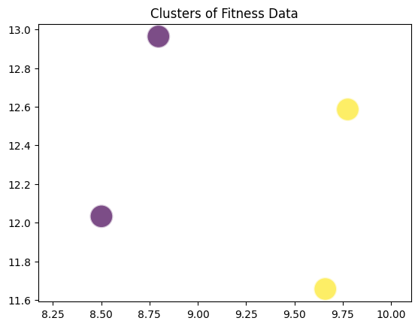

UMAP Evaluation by KMeans

Slide 25

Thumbnail Features

Slide 26



Three Thumbnail Features
Dataset Summarized Description
Dataset Thumbnail Features
Summarized description of dataset is incorporated in the catalog to provide an overview
Dataset variables which contain most of the information are also listed in the catalog
Key Descriptors
Key Topics
Key topics about which columns contain information, are also included in catalog

Slide 27
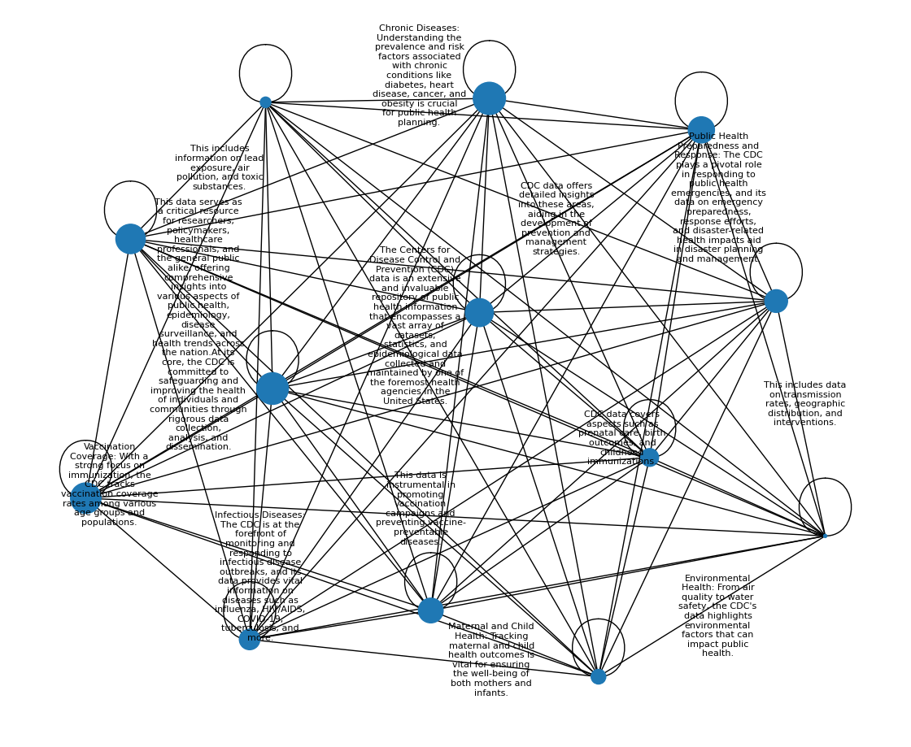
Sentence Importance Graph – Text Rank
Dataset Summarized Description
We have used Text Rank to generate summary of the dataset description.
TextRank is an algorithm used for text summarization and keyword extraction in natural language processing (NLP).
It was introduced as an extension of the PageRank algorithm, which Google uses to rank web pages in its search results.
TextRank is designed to identify the most important sentences or phrases in a piece of text.

Slide 28
Summarization Example
Actual Text
Text Rank
Summarized Text
The Centers for Disease Control and Prevention (CDC) data is an extensive and invaluable repository of public health information that encompasses a vast array of datasets, statistics, and epidemiological data collected and maintained by one of the foremost health agencies in the United States. This data serves as a critical resource for researchers, policymakers, healthcare professionals, and the general public alike, offering comprehensive insights into various aspects of public health, epidemiology, disease surveillance, and health trends across the nation. At its core, the CDC is committed to safeguarding and improving the health of individuals and communities through rigorous data collection, analysis, and dissemination. Infectious Diseases: The CDC is at the forefront of monitoring and responding to infectious disease outbreaks, and its data provides vital information on diseases such as influenza, HIV/AIDS, COVID-19, tuberculosis, and more. This includes data on transmission rates, geographic distribution, and interventions. Chronic Diseases: Understanding the prevalence and risk factors associated with chronic conditions like diabetes, heart disease, cancer, and obesity is crucial for public health planning. CDC data offers detailed insights into these areas, aiding in the development of prevention and management strategies. Vaccination Coverage: With a strong focus on immunization, the CDC tracksa vaccination coverage rates among various age groups and populations. This data is instrumental in promoting vaccination campaigns and preventing vaccine-preventable diseases. Environmental Health: From air quality to water safety, the CDC's data highlights environmental factors that can impact public health. This includes information on lead exposure, air pollution, and toxic substances. Public Health Preparedness and Response: The CDC plays a pivotal role in responding to public health emergencies, and its data on emergency preparedness, response efforts, and disaster-related health impacts aid in disaster planning and management. Maternal and Child Health: Tracking maternal and child health outcomes is vital for ensuring the well-being of both mothers and infants. CDC data covers aspects such as prenatal care, birth outcomes, and childhood immunizations.
Chronic Diseases: Understanding the prevalence and risk factors associated with chronic conditions like diabetes, heart disease, cancer, and obesity is crucial for public health planning.
Vaccination Coverage: With a strong focus on immunization, the CDC tracks vaccination coverage rates among various age groups and populations.
Environmental Health: From air quality to water safety, the CDC's data highlights environmental factors that can impact public health.
Maternal and Child Health: Tracking maternal and child health outcomes is vital for ensuring the well-being of both mothers and infants.

Slide 29

Key Topics Extraction using LDA
Scope
Methodology
Application
Discretize Numerical Data
Discovering 'topics' in text documents
Convert numerical features into categorical bins
Assumption
Encode Categorical Data
Documents are mixtures of topics, and topics are mixtures of words
Apply one-hot encoding to categorical variables
Feature Engineering
Goal
Create 'documents' by combining the binned numerical and encoded categorical features
Infer topic distribution within documents and word distribution within topics
Output
Apply LDA
It can generate topics for a dataset
Run LDA on the transformed dataset.
Interpret each topic as a mixture of bins/categories

Slide 30
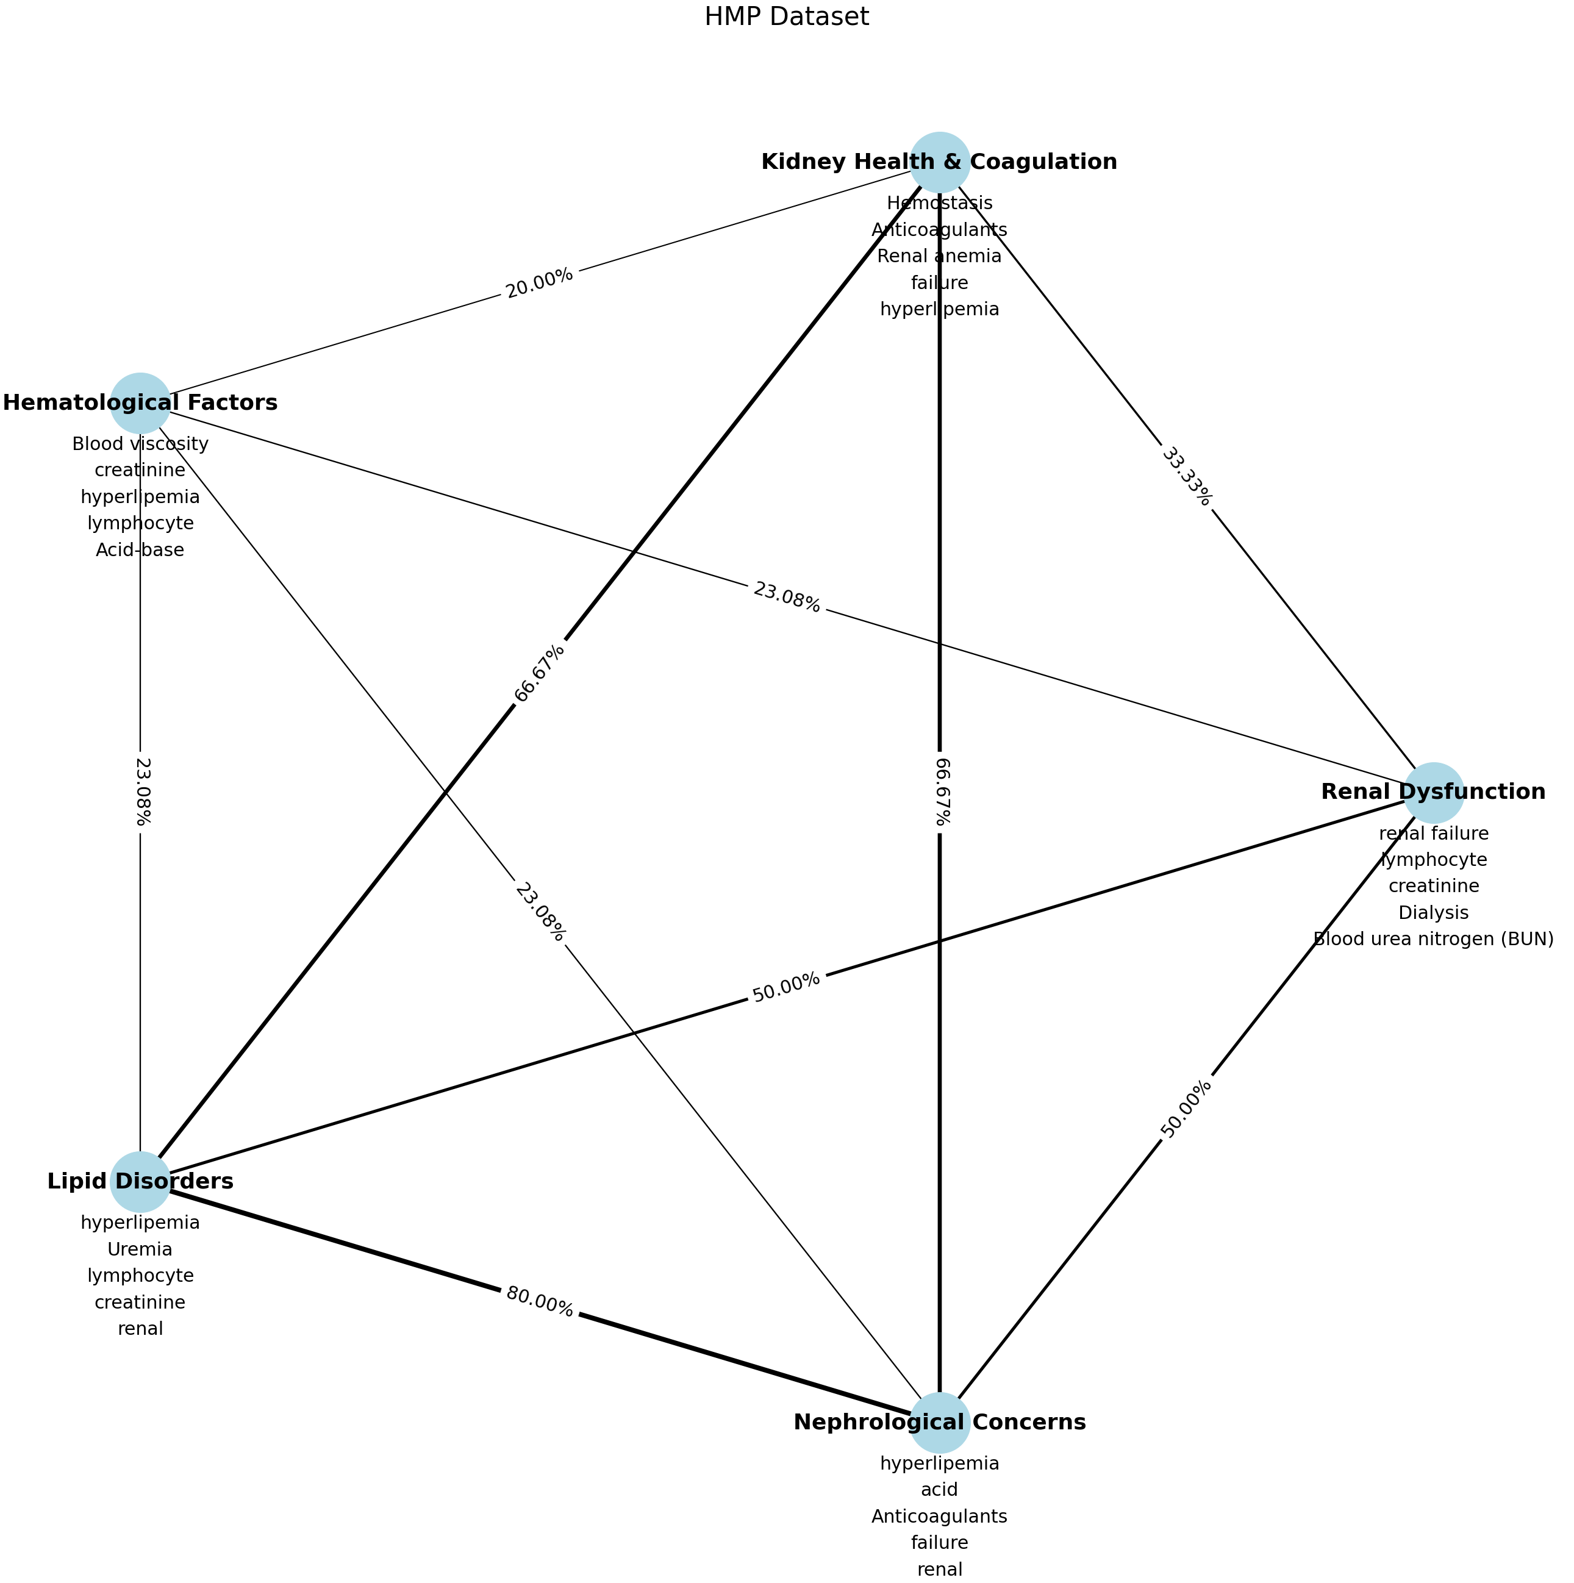
Key Topics
Each node represents a topic and is annotated with the topic name and its top 5 words.
The edges between the nodes vary in thickness, indicating the percentage of shared words between the topics.
Labels on the edges provide the exact percentage of shared words between the connected topics.
HMP

Slide 31



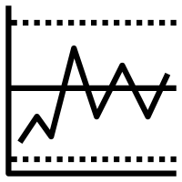
Key Descriptors Key variables are identified using following parameters
Information Content
Consistency
Key variables contain essential information or unique patterns that contribute significantly to the overall understanding of the dataset
Key variables maintain their significance and relevance across different subsets or samples of the dataset
Correlation
Variability
Variables with higher correlation with most of the other variables are important from analytics perspective in the dataset
Variables that demonstrate significant variability or spread within the dataset, capturing diverse ranges of values and contributing to the dataset's overall information content

Slide 32
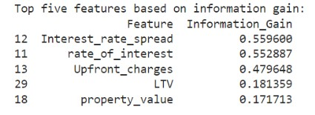
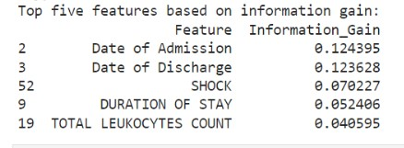
Dataset's Key Descriptors
Loan Default Dataset
Hospital Admission Dataset

Slide 33

Results, UI & Future Steps

Slide 34
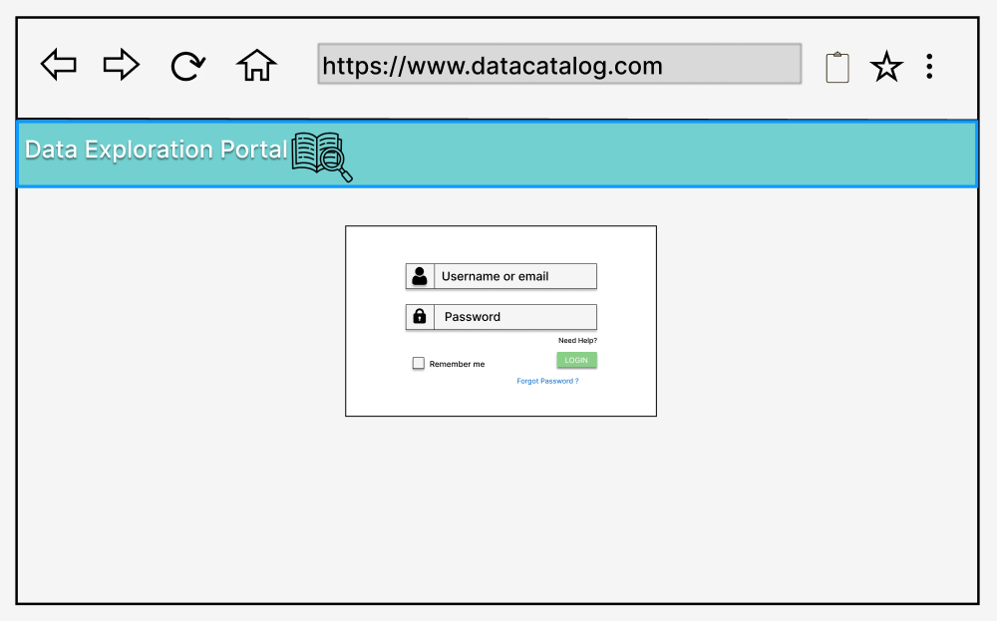
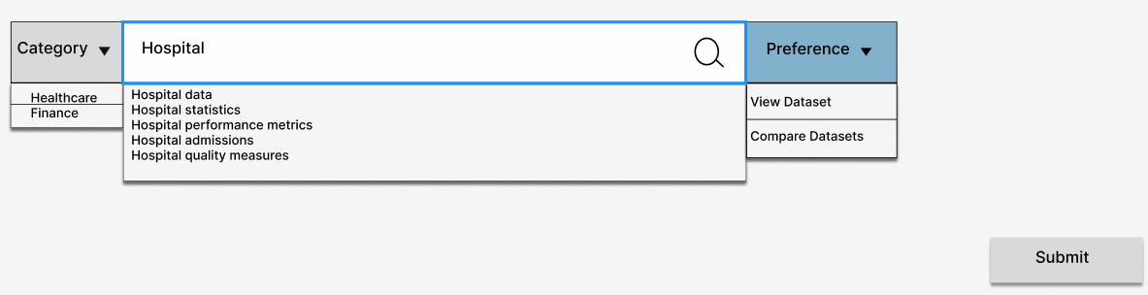
USER INTERFACE
SCREEN 1

Slide 35
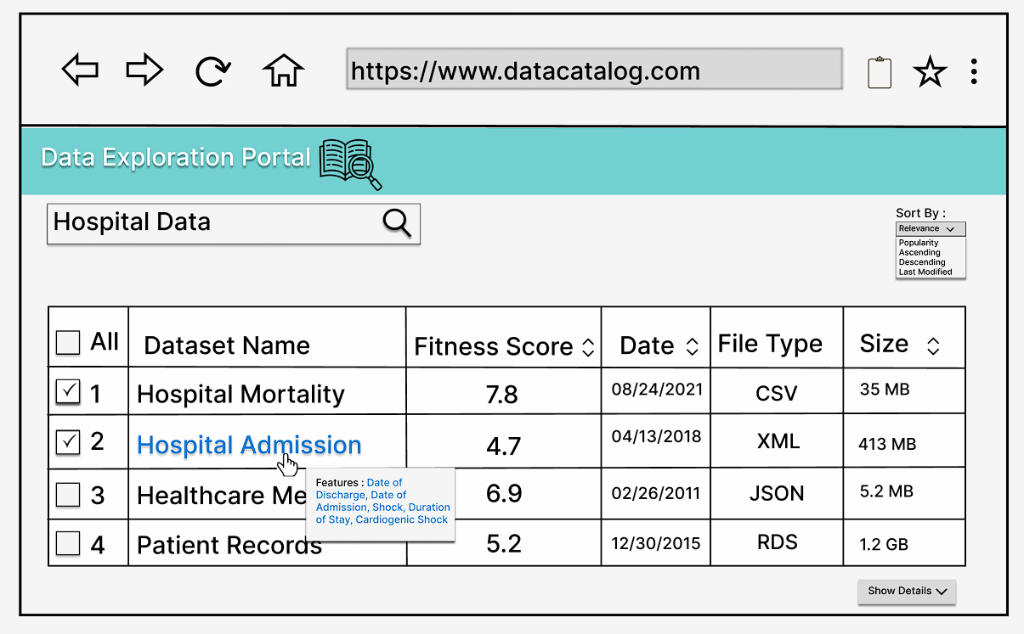
SCREEN 2

Slide 36
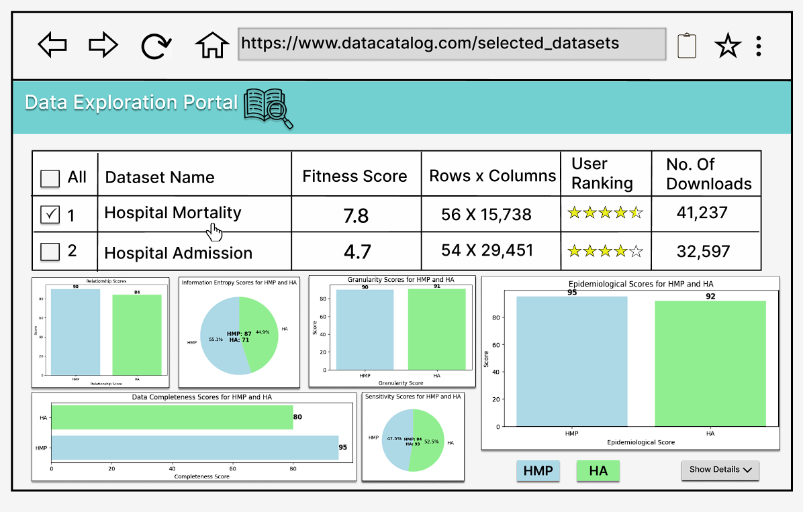
SCREEN 3

Slide 37
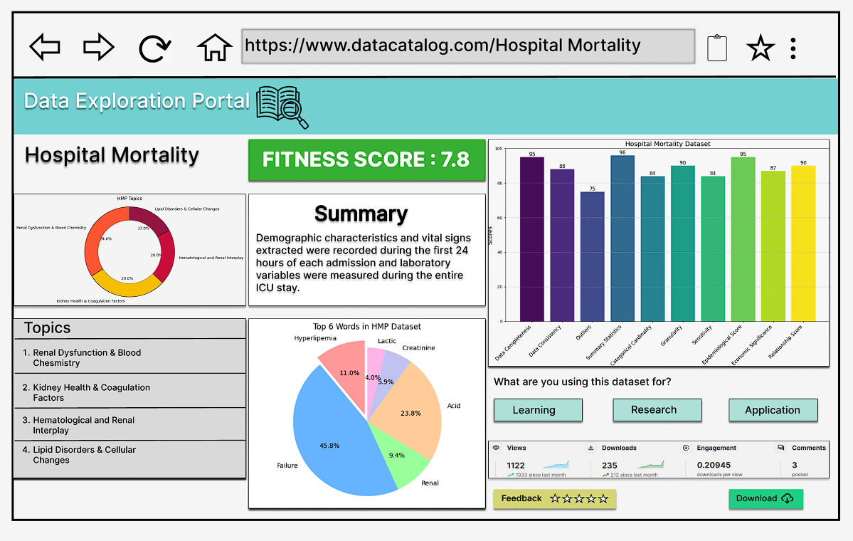
SCREEN 4

Slide 38
Project Findings
Discovering UMAP's Superiority in Data Aggregation
Domain-Specific Disparities in Fitness Features
1
2
UMAP surpassed traditional approaches.
Preserved high-dimensional data structure effectively.
Datasets share general fitness traits but differ significantly in specific features.
3
4
Dramatic Reduction in Data Selection Efforts through Data Catalog Enhancement
Thumbnail Features Bridge
Addressing data catalog issues can lead to an 80% reduction in selection time.
Key bridge between raw data and insights.
Vital role in informed decisions and deeper data understanding.

Slide 39
FUTURE STEPS
As the system gains more users and handles datasets, optimize its performance and scalability to maintain responsiveness and reliability over undiscovered domains.
Enhance the scoring model by incorporating advanced machine learning techniques, including natural language processing (NLP) for text-based datasets and domain-specific algorithms.
Periodically benchmark the scoring system against external benchmarks or datasets to validate its performance and accuracy.

Slide 40

ANY QUESTIONS?

Slide 41

THANK YOU

